Slide 1
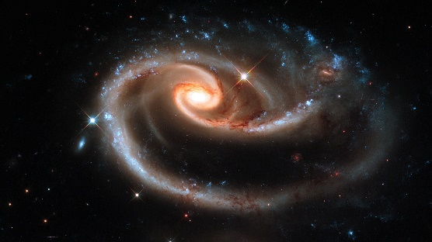
The Dark Side of Galaxy Evolution
Galaxies as a dynamic, evolving population
Rhys Taylor

Slide 2
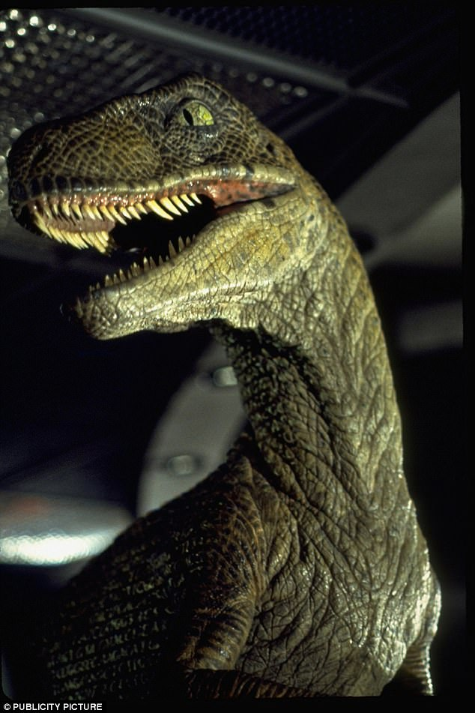
Lecture 3 : Be Careful What You Wish For
Introduction to galaxy evolution theory
Monolithic collapse versus hierarchical merging
The limits and advantages of simulations
Pure dark matter
Inclusion of baryons, missing physics
Resolution effects
Why do we interpret the data in any particular way ?
The importance of being subjective
Being right isn’t good enough
Selection effects
Falsification isn’t everything

Slide 3
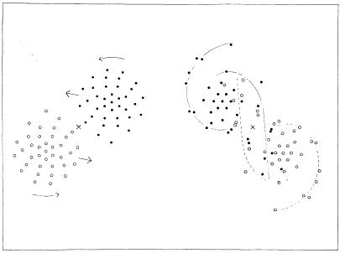
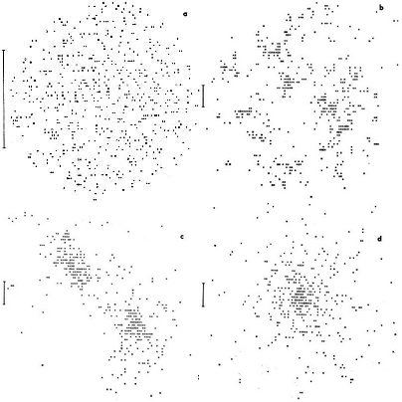
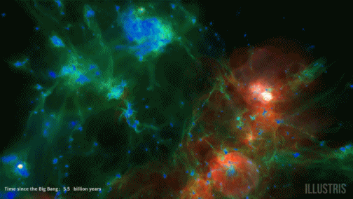
Where did it all go wrong ?
First numerical simulation : 1941 using light bulbs
37 particles per galaxy
Found interaction of two discs produced spiral features
Early simulations (1960-1980) limited to gravity, n <1,000
Modern simulations :
n ~10¹² (though smaller n still useful !)
Dark matter, stars, gas, dust
Chemical evolution
Magnetic fields
But… many, many free parameters !
Notes:
The light bulb simulations :
https://ned.ipac.caltech.edu/level5/Biviano2/Biviano5_1.html
Illustris simulation :
http://www.illustris-project.org/

Slide 4
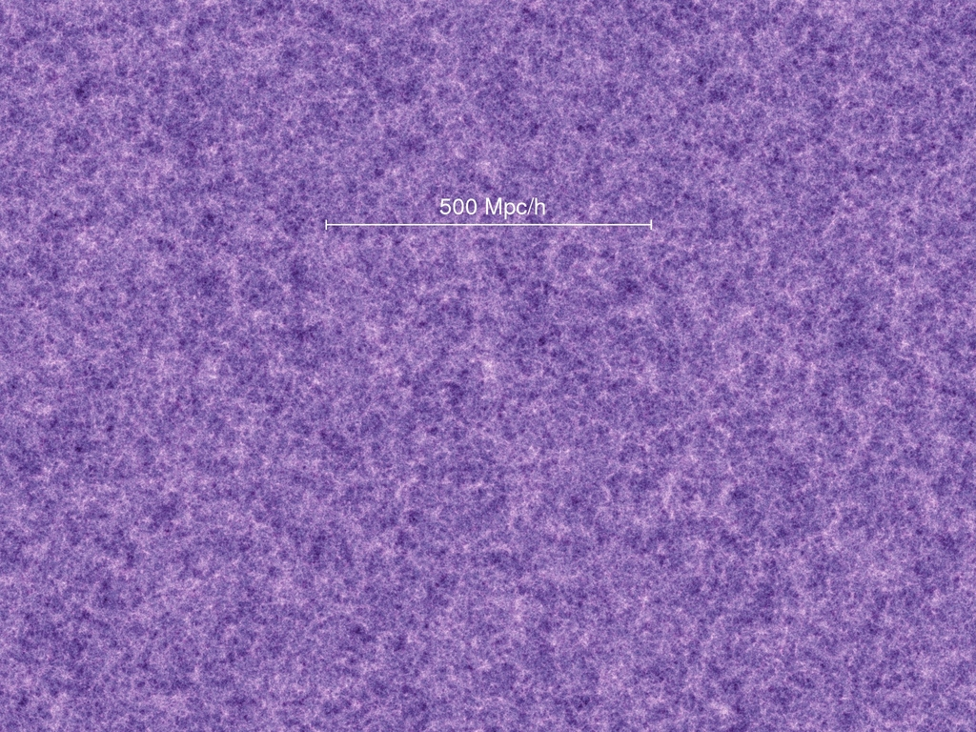
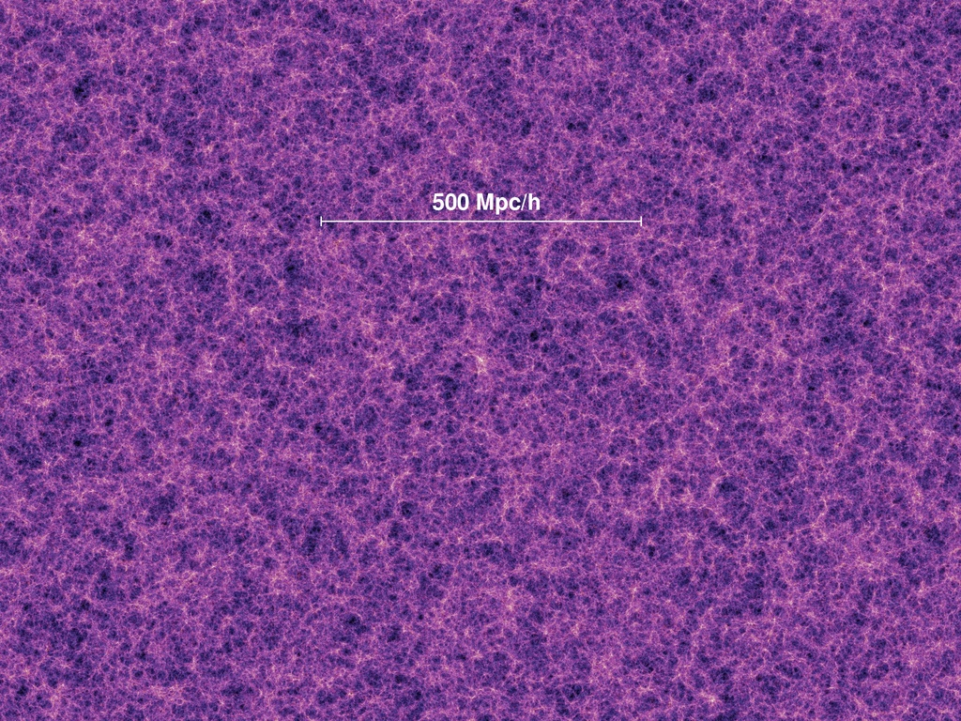
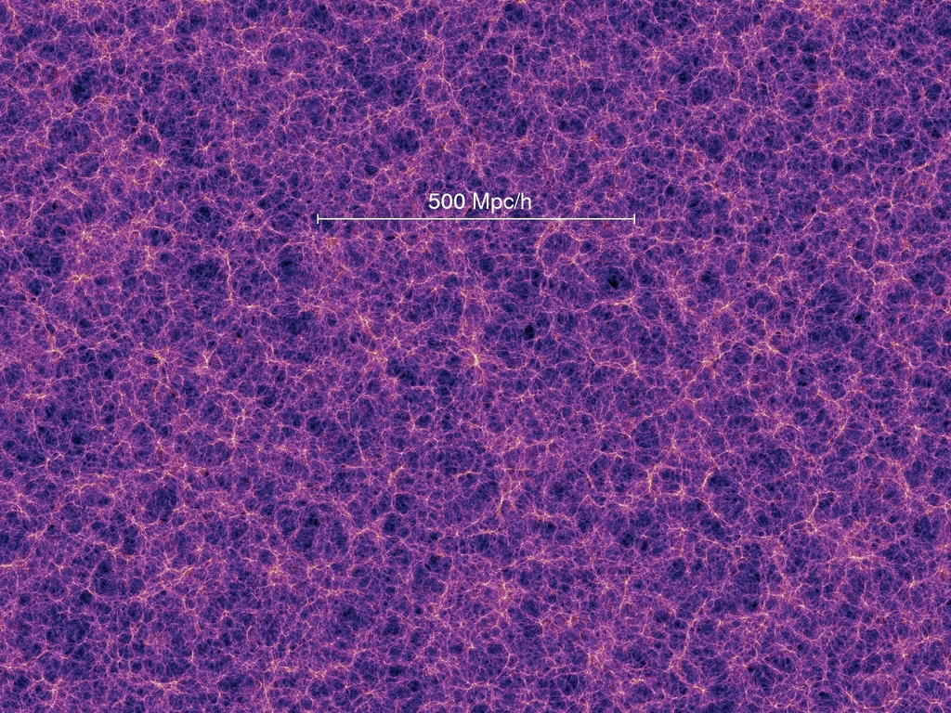
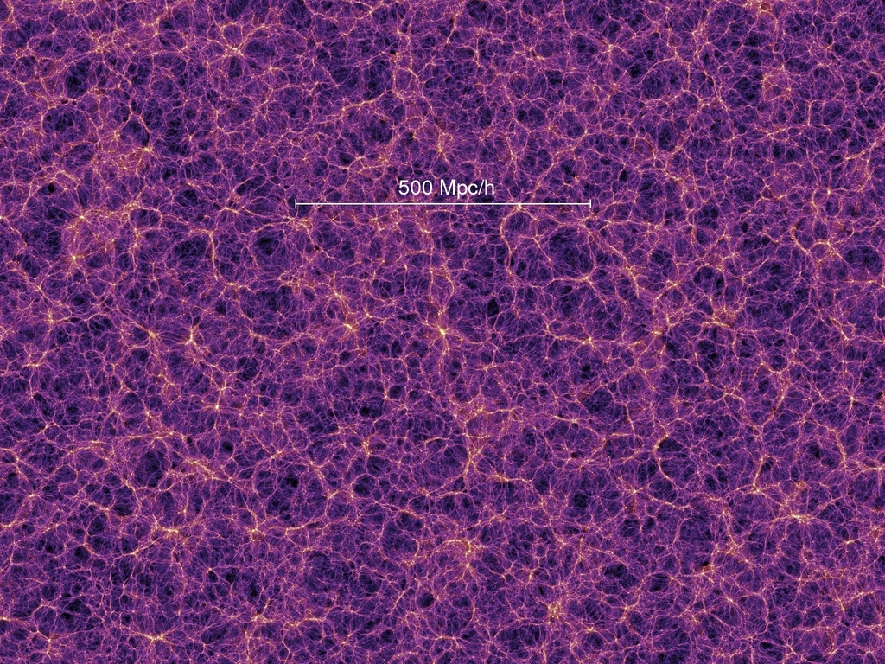
Keep It Simple, Stupid
Start simple, gradually increase complexity
Pure n-body dark matter justified :
Dark matter ~x5 more massive than baryons
Simple physics
Works very well on large scales !
Pretty lousy on small scales
Initially problems getting any substructure to form at all
Subsequent problems forming far too much substructure (~x10)
How to relate substructure to galaxies ?
Notes:
Review of historical development :
https://arxiv.org/abs/1009.4505
Millenium Simulation
https://wwwmpa.mpa-garching.mpg.de/galform/virgo/millennium/
Moore : first missing satellite simulation
http://adsabs.harvard.edu/abs/1999ApJ...524L..19M
Interactive cosmic web :
http://cosmicweb.barabasilab.com/

Slide 5
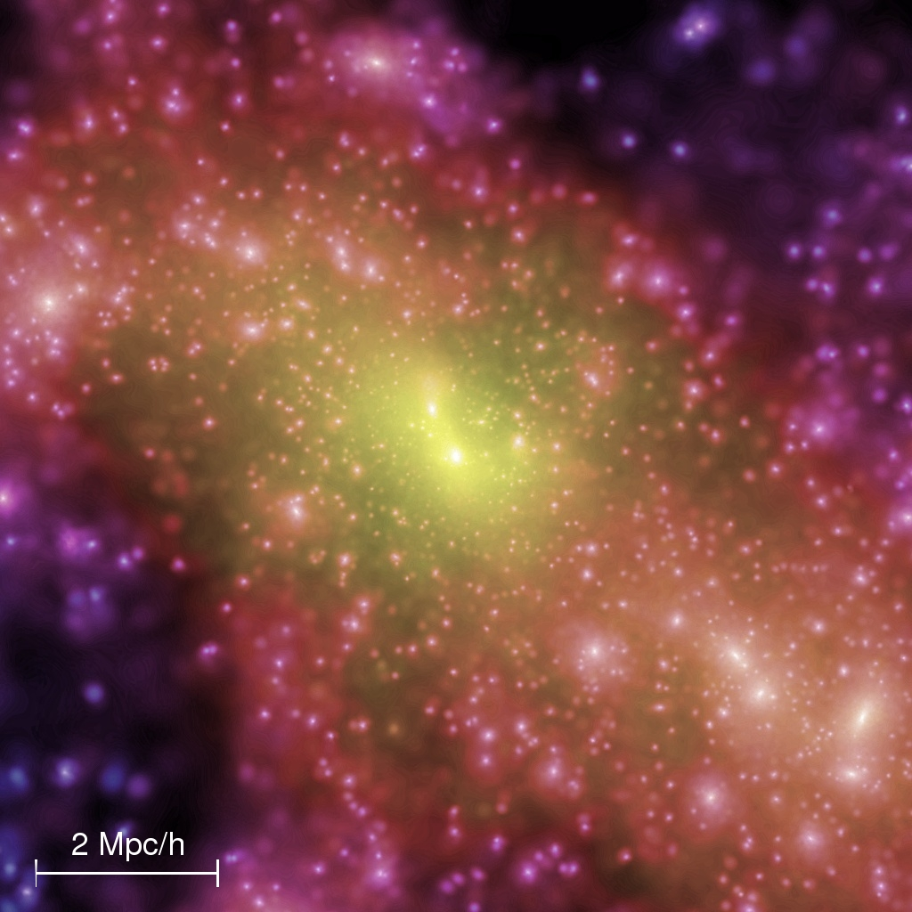
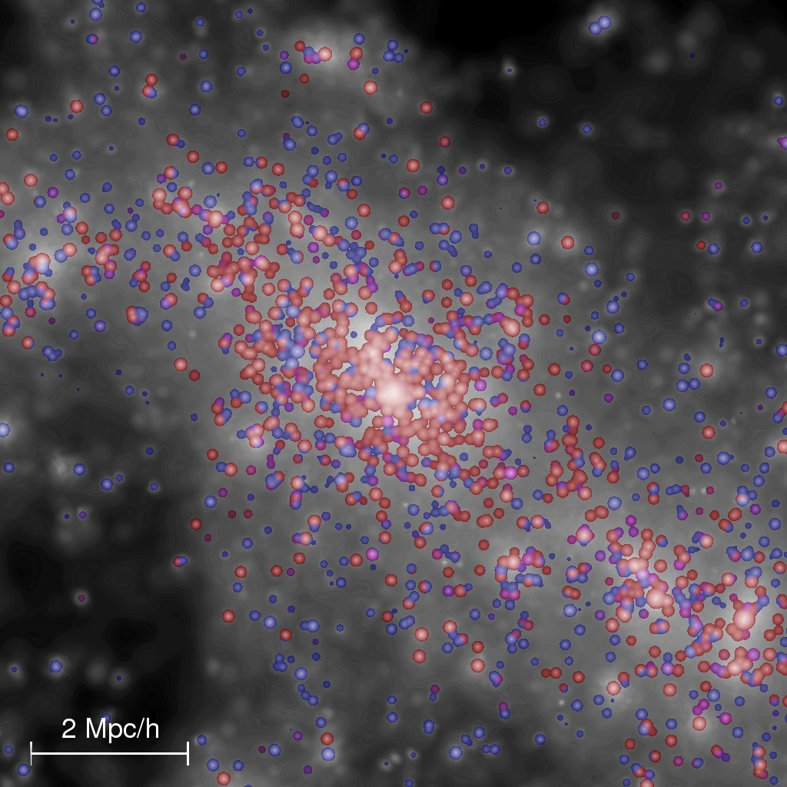
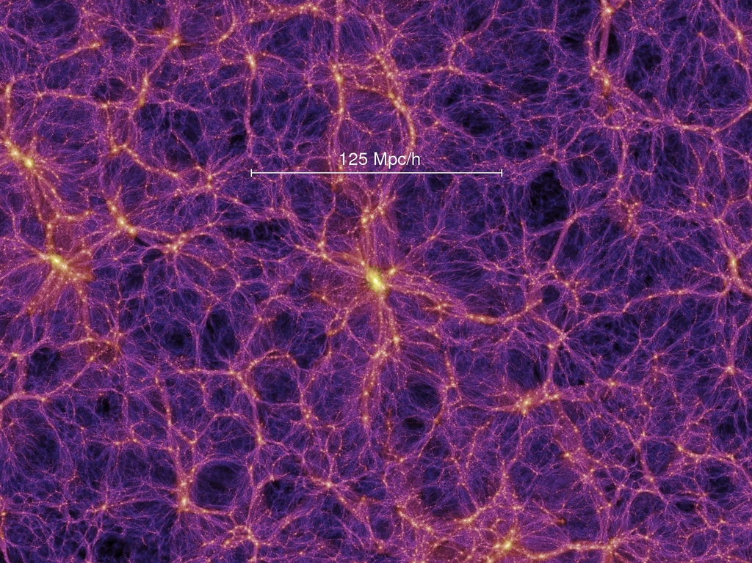
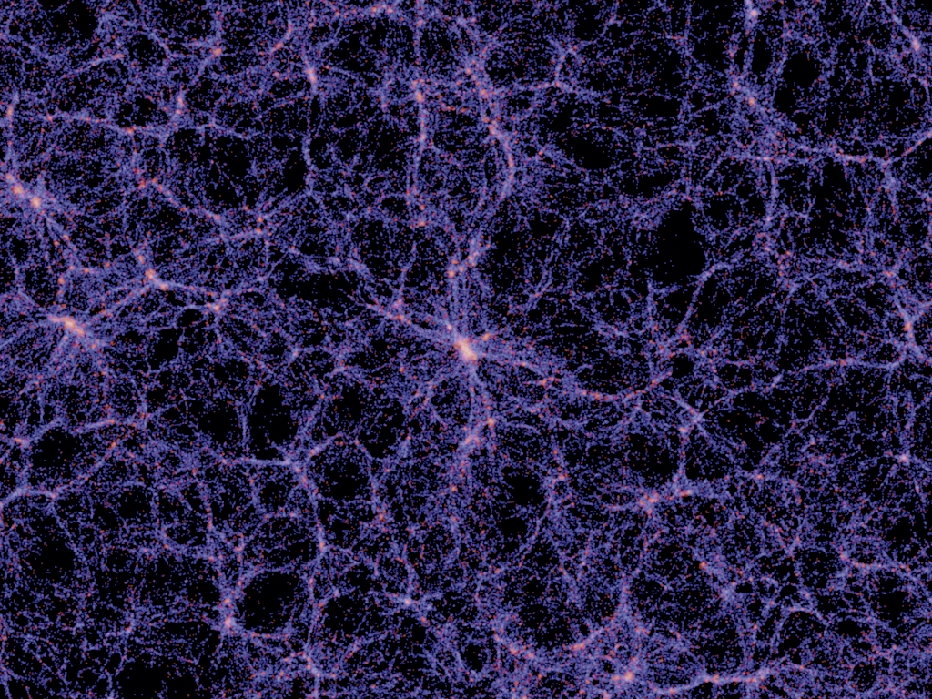
The missing satellite problem
Observational data :
Stellar mass, gas mass, colour, luminosity, 3D spatial position, line-of-sight velocities
Simulated data :
Positions of dark matter particles, velocities
Baryonic mass << dark matter mass, and baryonic physics too complicated
Predict baryon distribution via semi-analytic models
Or try and simulate the baryonic physics
Or, try a completely different model
Or… change your interpretation !
Every galaxy has a dark matter halo, but does every dark matter halo have a galaxy ?

Slide 6
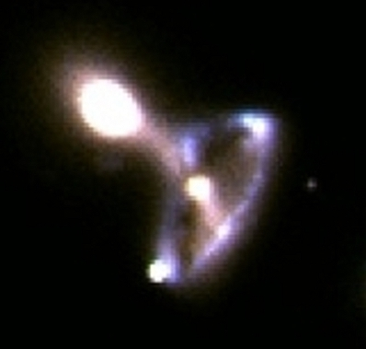
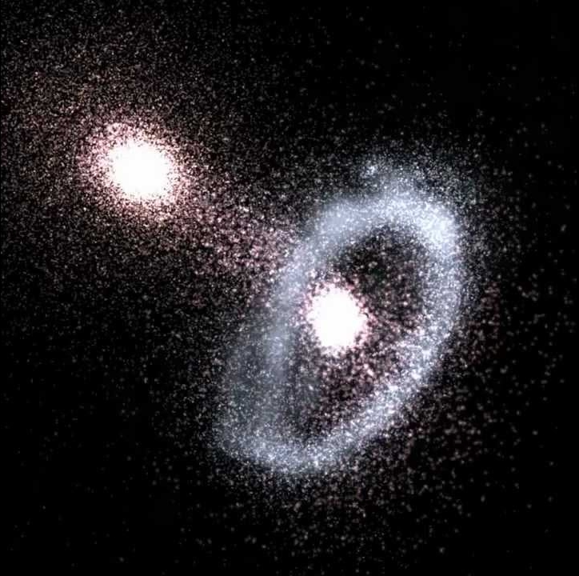
Simulations aren’t magical (they’re just very complicated !)
Simulations have similar sorts of limits to observational data :
Far fewer particles than in reality
Star particles are not the same as stars
Increasing number of particles not always possible
Difficult to understand what’s happening in a simulation even though in principle you know everything
Have to try and compare like-for-like between simulations and reality (e.g. synthetic observations)
Requires even more physics and potentially adds uncertainty
Requires detailed knowledge of the observational methods
Notes:
Auriga’s Wheel :
http://adsabs.harvard.edu/abs/2012MNRAS.423..543S

Slide 7
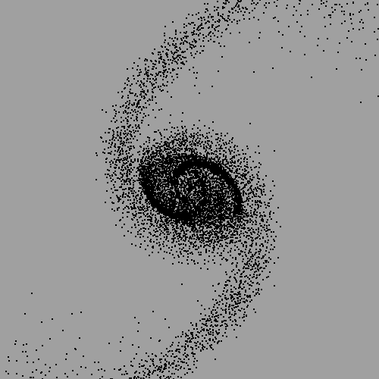
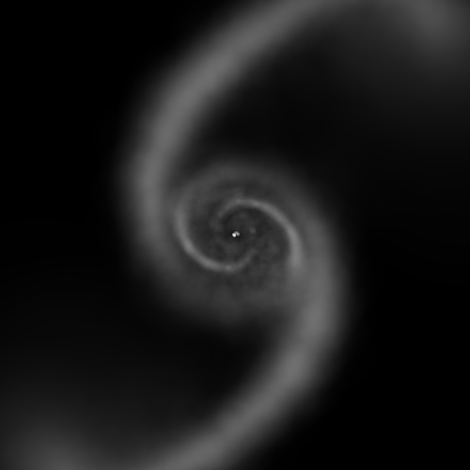
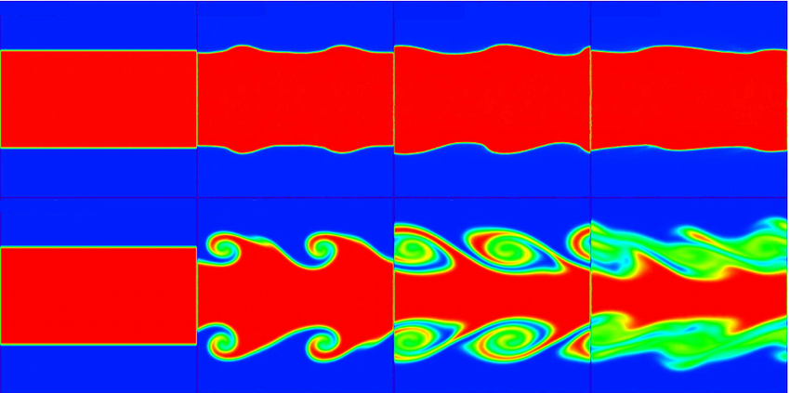
Practical methods of simulations
Smoothed Particle Hydrodynamics
Fluid composed of finite number of particles
Each particle is a member of a “kernel” in which hydrodynamic properties are calculated
Can trace precise history of each particle
Problems reproducing instabilities
Grid codes
Gas modelled as a continuous fluid within cells
Grid cells may be of variable size
Better reproductions of real instabilities
Difficult to trace gas
Notes:
Kelvin-Helmholtz instability figure :
https://www.researchgate.net/figure/272845222_fig6_Figure-8-Kelvin-Helmholtz-instability-We-show-thin-slices-of-specific-entropy-through

Slide 8
Knowing everything and nothing
Knowing the underlying physics in your simulation doesn’t mean you can predict what it does or even understand it afterwards
Atomic physics tells you nothing much about macroscopic physics
Many parameters have to be observed, can’t recreate in a laboratory !
Trivial example : making mistakes
Sometimes small instabilities can amplify
Better example : what’s the cause of the damage ?
One object may approach more closely, or more slowly, or be more massive
Data visualisation not trivial either !
Notes:
For the harassment simulation see :
http://adsabs.harvard.edu/abs/2017MNRAS.467.3648T

Slide 9
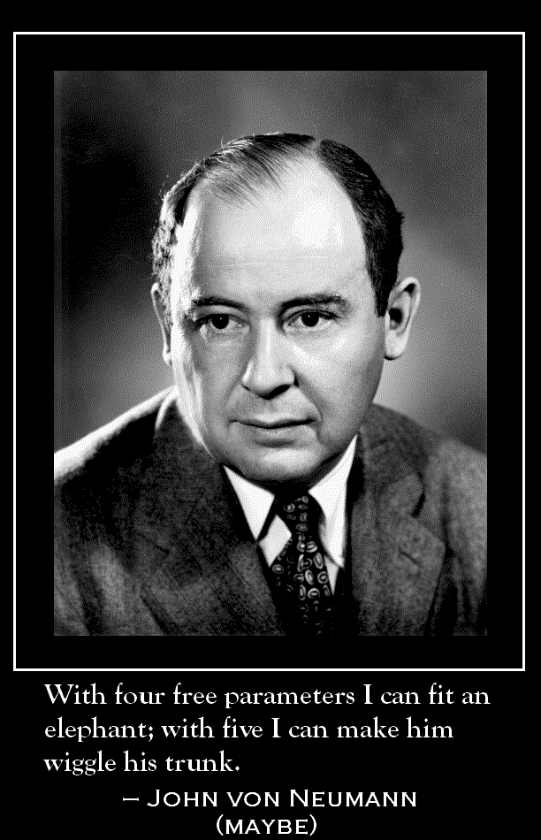
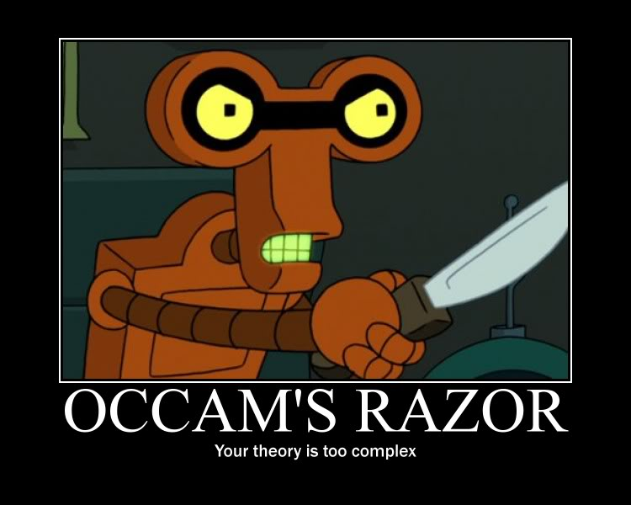
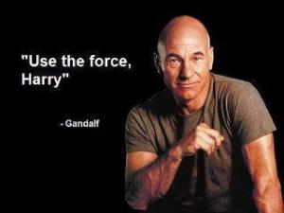
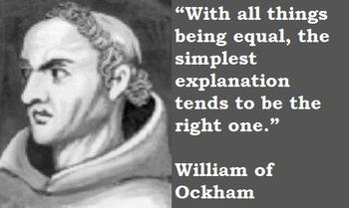
… maybe the theory is too simple ?
The more free parameters, the greater the margin for error => the easier it is to make a model fit the data
Occam’s Razor must be handled carefully !
The simplest explanation tends to be the right one
Entities must not be multiplied beyond necessity
We consider it a good principle to explain the phenomena by the simplest hypothesis possible
Prefer simple explanations
Simple explanations are easier to test and harder to fudge
But… making things too simple can be equally disastrous !
“Entities must not be multiplied beyond necessity.”
Jodie Foster of Contact

Slide 10
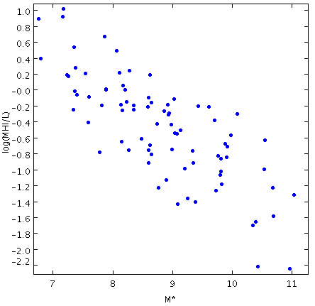
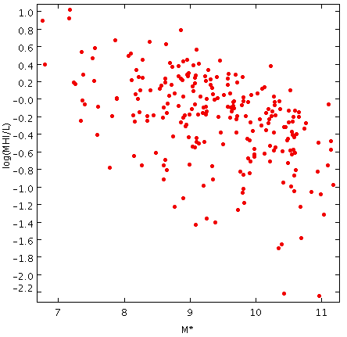
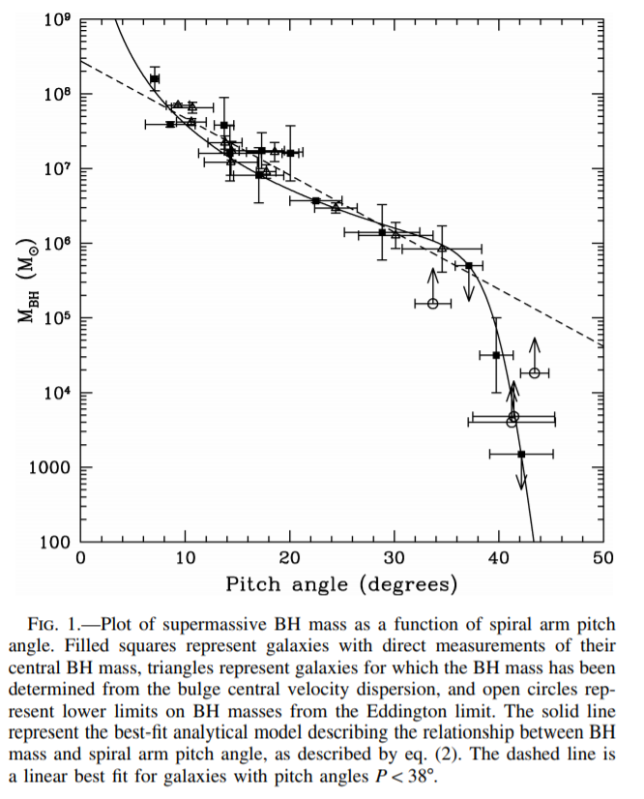
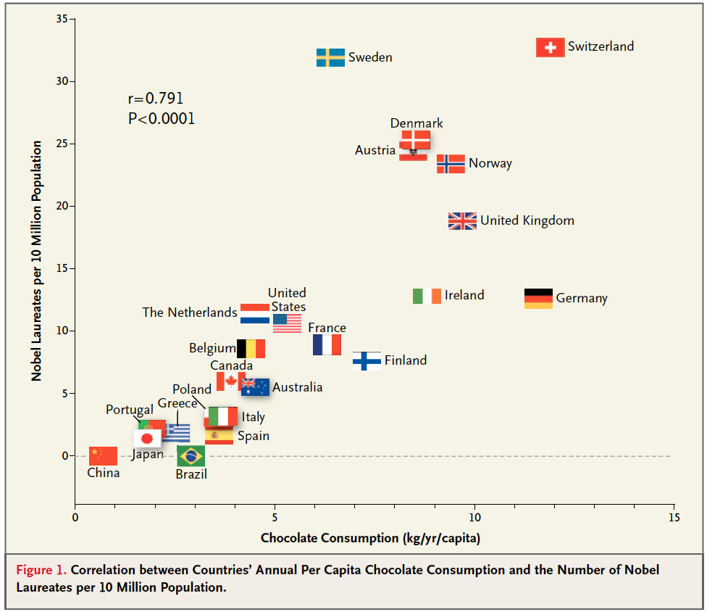
Selection effects
Baryons (probably) can’t influence the formation of halos
But maybe the baryons are just the visible tip of the dark matter iceberg ?
Need a mechanism to restrict their presence to only certain halos : this is not naturally suggested by simulations
Selection effects can affect both theory and observations; essentially a variation of comparing apples and oranges
More subtle effects : correlation doesn’t equal causation
Multiple parameters can be controlled by a common cause
Notes:
Spurious correlations :
http://www.tylervigen.com/spurious-correlations
Eating chocolate wins Nobel prizes :
http://www.businessinsider.com/chocolate-consumption-vs-nobel-prizes-2014-4
Pitch angle –SMBH relation :
http://adsabs.harvard.edu/abs/2008ApJ...678L..93S

Slide 11
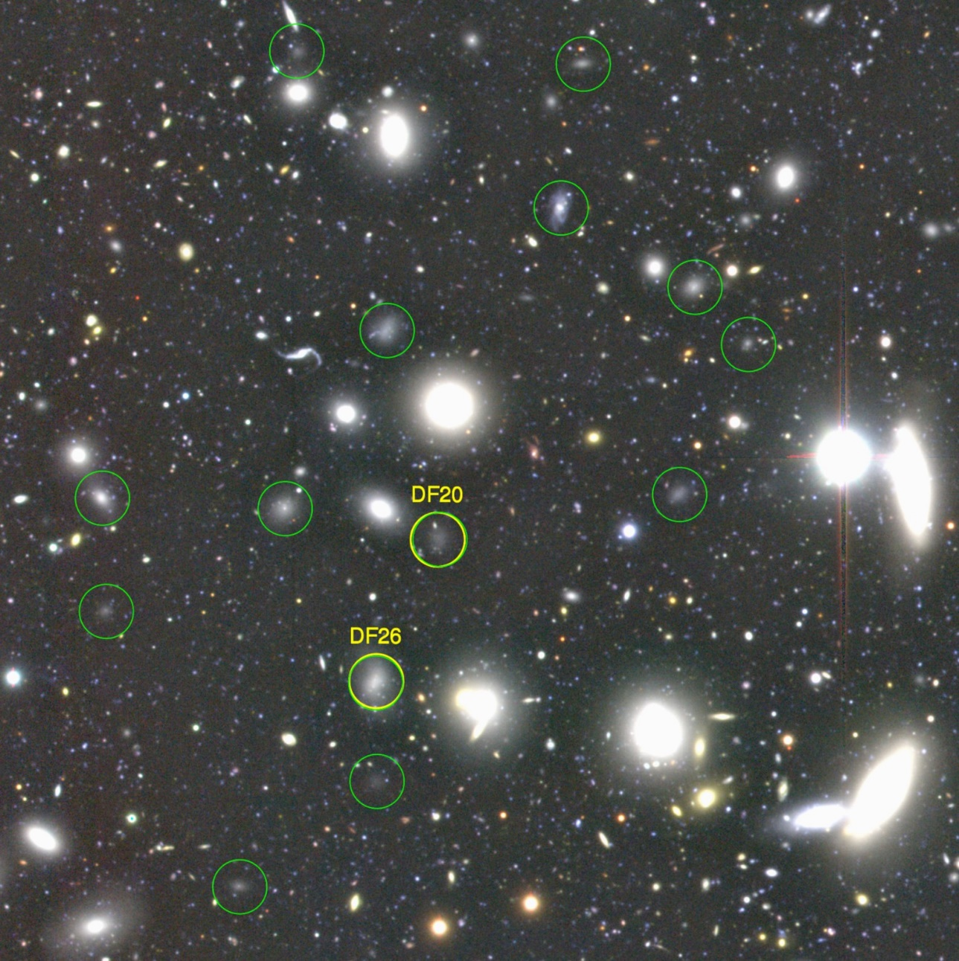
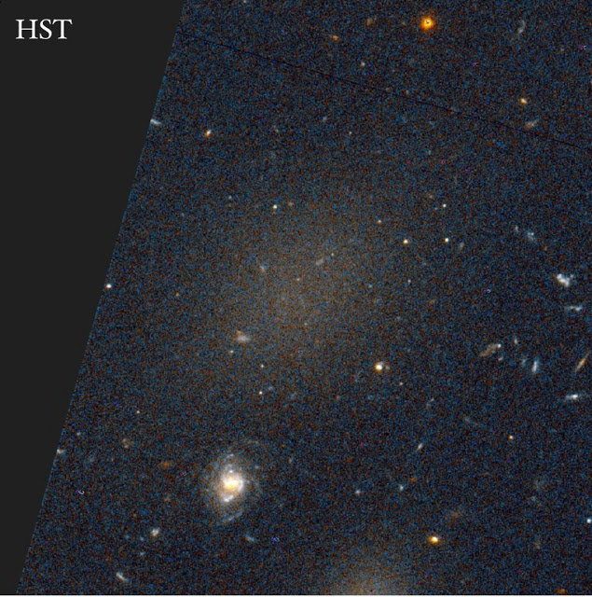
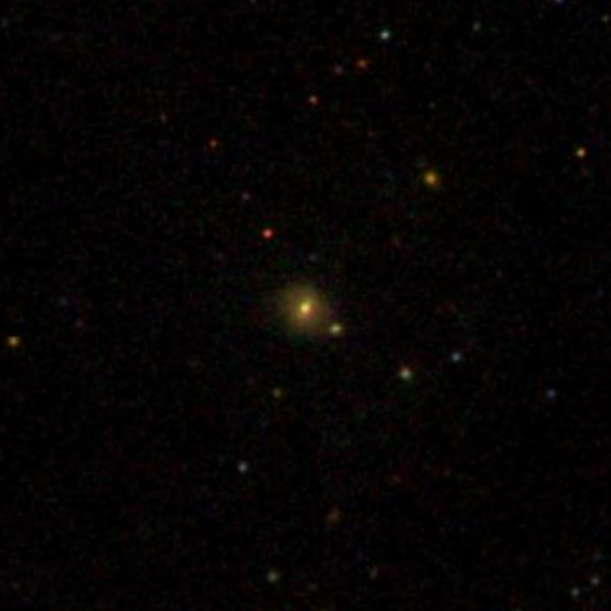
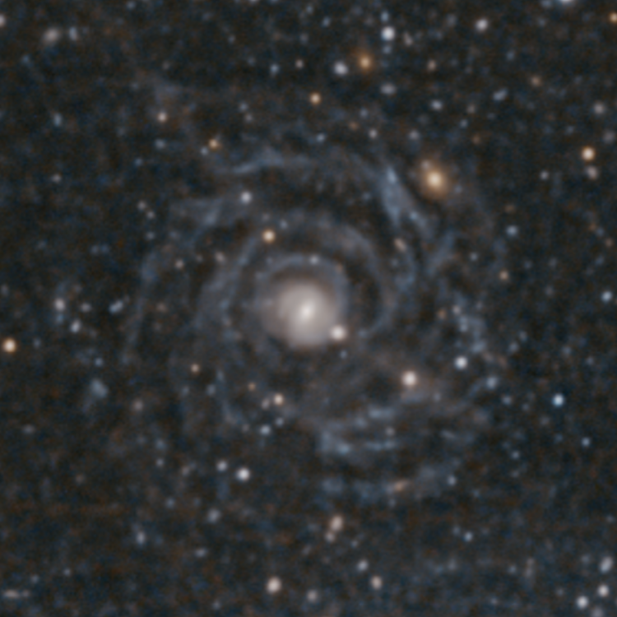
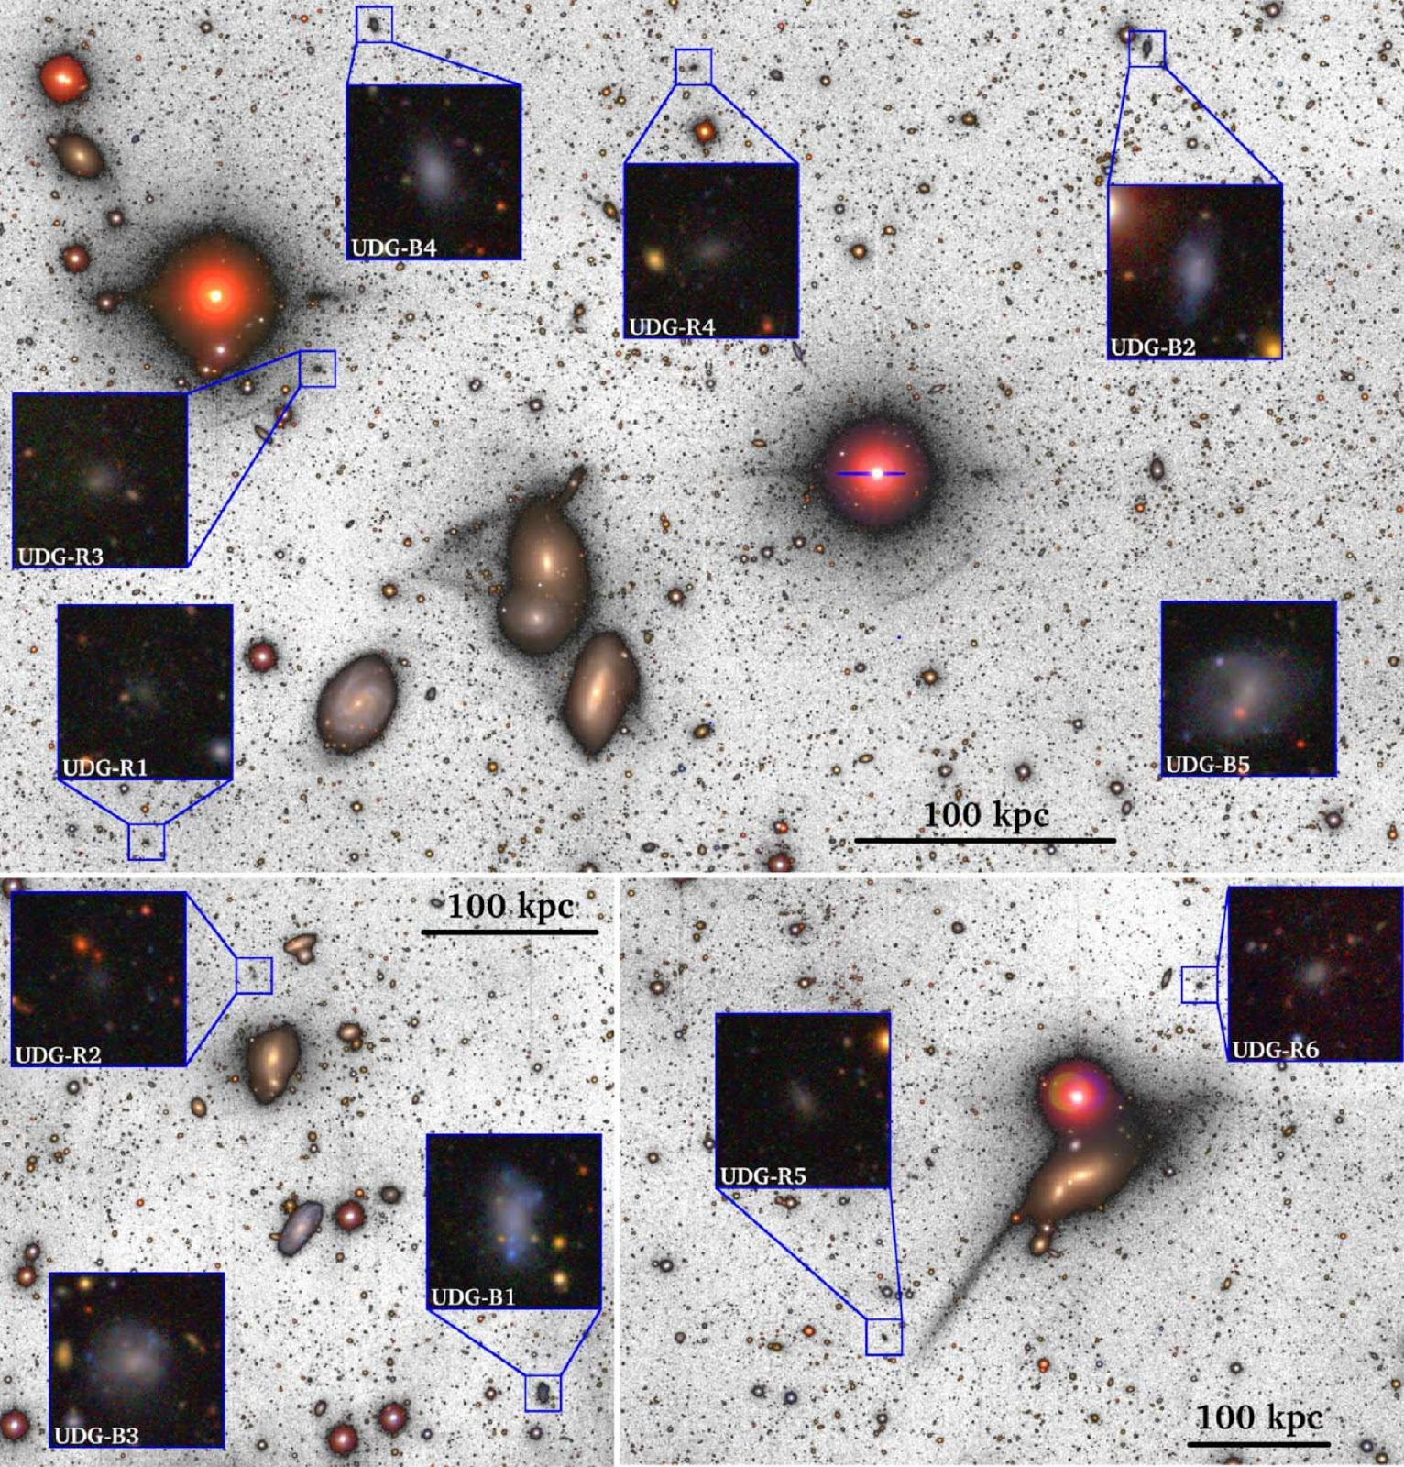
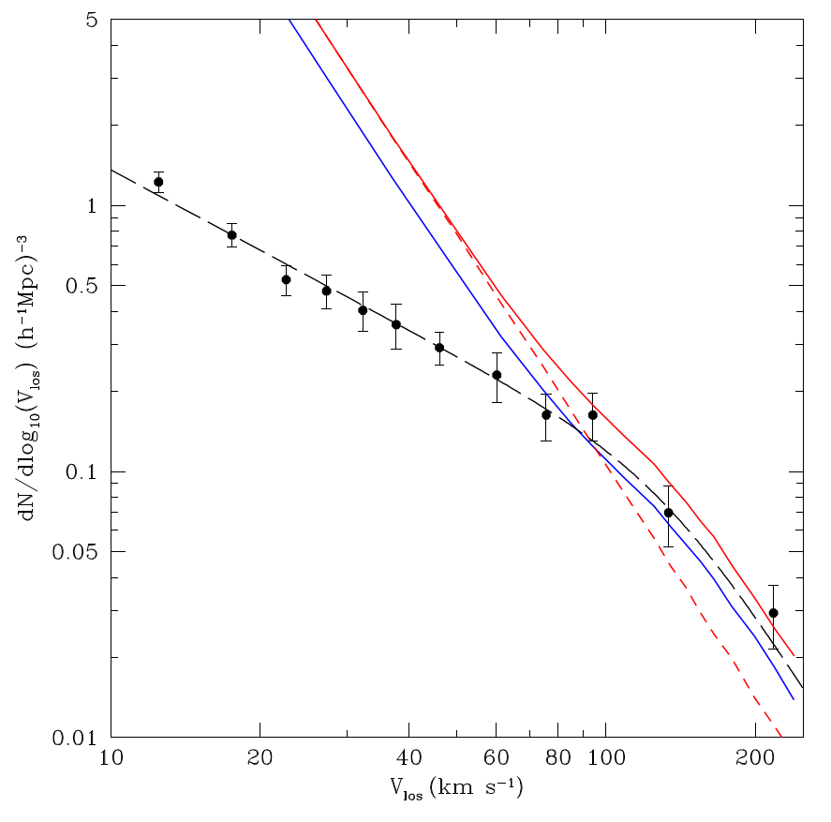
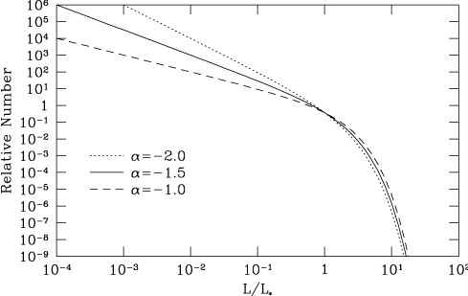
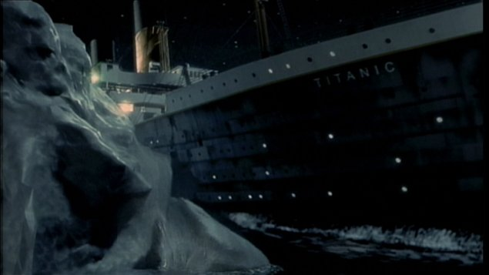
Unknown unknowns
Selection effects often hard to even be aware of
LSB galaxies known for several decades but as exotica
Now, UDGs common, previously hidden component
Defined as objects with R_{e} > 1.5 kpc and μ_{g} > 23 mag arcsec ⁻²
Roughly, MW-sized objects but 100-1,000x fainter
Huge dwarfs or failed giants ?
Multiple formation mechanisms ?
Are they themselves just the tip of an even larger iceberg ?
Do they help solve the missing galaxy problem or just make it worse ?
Notes:
Mike Disney predicted population of LSBs are far back as 1976 (though in 2015 was still claiming that CCDs wouldn’t be able to detect them !)
http://adsabs.harvard.edu/abs/1976Natur.263..573D
https://arxiv.org/abs/1603.02590
Malin 1 deep image :
http://adsabs.harvard.edu/abs/2015ApJ...815L..29G
Van Dokkum discovery of UDGs :
http://adsabs.harvard.edu/abs/2015ApJ...798L..45V
Koda UDGs in Coma :
http://adsabs.harvard.edu/abs/2015ApJ...807L...2K
Roman UDGs in groups :
http://adsabs.harvard.edu/abs/2017MNRAS.468.4039R

Slide 12
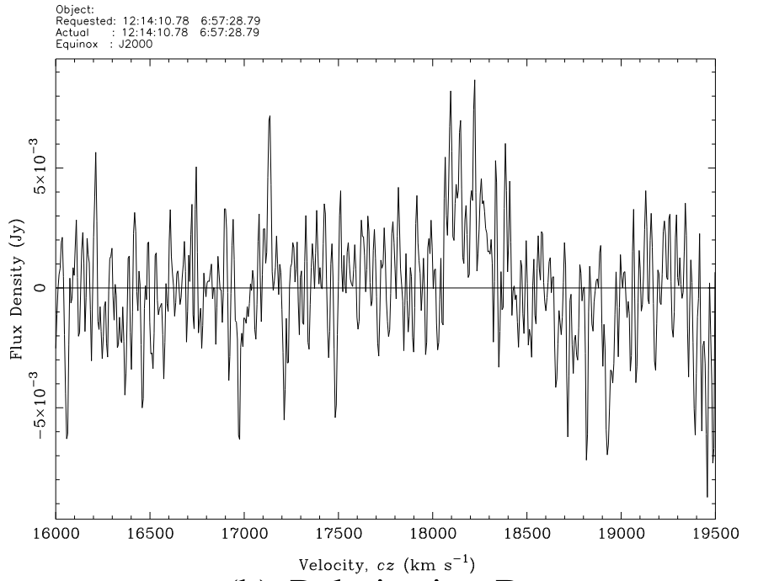
If it disagrees with experiment…
Actually, this is very hard to establish in practise !
Does it really disagree ? Did you make a mistake ? Errors are often difficult to quantify
High S/N values of limited help !
Being objective is not the same as being correct (recall completeness and reliability from lecture 2)
Extreme version : have to be able to falsify scientific theories
But impossible to falsify if it takes millions of years !
Maybe able to falsify in principle, but not in practise – are the situations really so different ?
Always better to be able to falsify, just not always possible

Slide 13
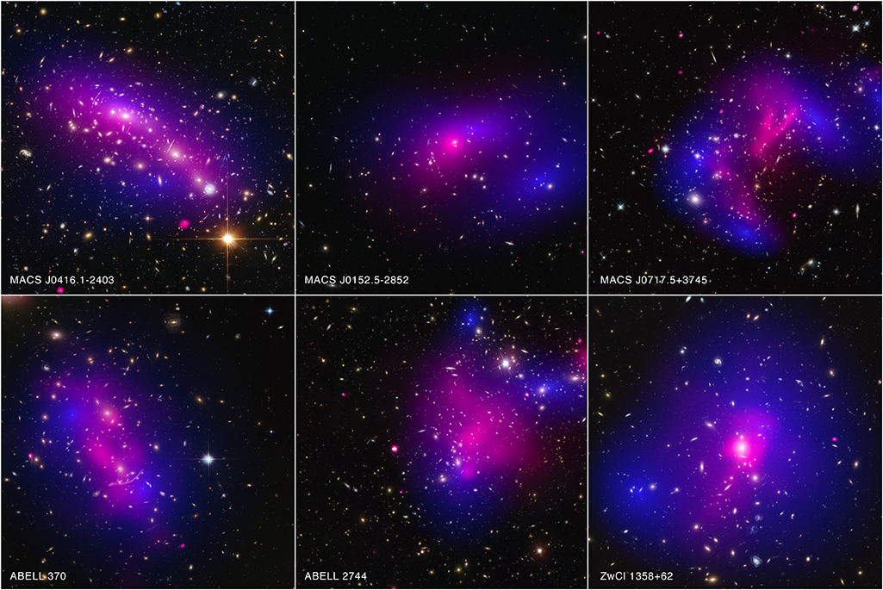
If it disagrees with experiment… it’s annoying
Newtonian gravity / relativity is well-established in many other cases
Dark matter is also incredibly successful in other situations :
Rotation curves
Large-scale structure
Galaxy clusters (especially collisions)
Throwing away either or both of these notions may well be necessary, but we probably shouldn’t do it on a whim
Perhaps dark matter works, but we just don’t understand how galaxies form ?
Notes:
Bullet cluster simulations, including other models (includes link to paper in description) :
https://www.youtube.com/watch?v=rLx_TXhTXbs
How probable is the existence of the Bullet Cluster ?
Not probable at all :
http://adsabs.harvard.edu/abs/2010ApJ...718...60L
Rare but not worryingly rare :
http://adsabs.harvard.edu/abs/2015JCAP...04..050K
Probably not rare at all : collision velocity has been inaccurately determined :
http://adsabs.harvard.edu/abs/2015JCAP...02..038L
And another one claiming the speed has been measured inaccurately so everything is just fine :
http://adsabs.harvard.edu/abs/2007MNRAS.380..911S
Other colliding clusters :
http://chandra.harvard.edu/photo/2015/dark/

Slide 14
Maybe it’s only a little bit broken
Monolithic collapse
Simplest solution
No missing satellite problem
Galaxy properties scale largely with mass
Doesn’t explain distribution of satellite galaxies
Not self-consistent with standard model
Hierarchical merging
CDM predicts smallest structures form first
Mergers easier at high redshift, allowing rapid growth… but maybe not rapid enough
Galaxy properties seem strongly mass-dependent
Satellite distribution incorrect

Slide 15
Maybe it’s only a little bit broken
Monolithic collapse
Simplest solution
No missing satellite problem
Galaxy properties scale largely with mass
Doesn’t explain distribution of satellite galaxies
Not self-consistent with standard model
Hierarchical merging
CDM predicts smallest structures form first
Mergers easier at high redshift, allowing rapid growth… but maybe not rapid enough
Galaxy properties seem strongly mass-dependent
Satellite distribution incorrect
Notes:
Monolithic collapse movies :
http://www.astro.cf.ac.uk/pub/Alistair.Nelson/indexgf.html
Hierarchical merging movie :
https://www.youtube.com/watch?v=n0jRObc7_xo
Monolithic collapse : globular clusters should all have same age, contrary to observations
http://physicsanduniverse.com/formation-milky-way/
CDM predicts smaller structures should form first :
https://ned.ipac.caltech.edu/level5/Sept05/Gawiser/Gawiser1.html
More details of monolithic collapse :
http://astro.u-strasbg.fr/~koppen/ue7b/docs/EoG_9FormationMonolithic.pdf
A bit more on hierarchical merging :
https://www.astro.umd.edu/~richard/ASTRO620/McCarthy_Mitchell.pdf
General stuff on galaxy formation :
http://star-www.st-and.ac.uk/~spd3/Teaching/AS3011/AS3011_14.pdf

Slide 16
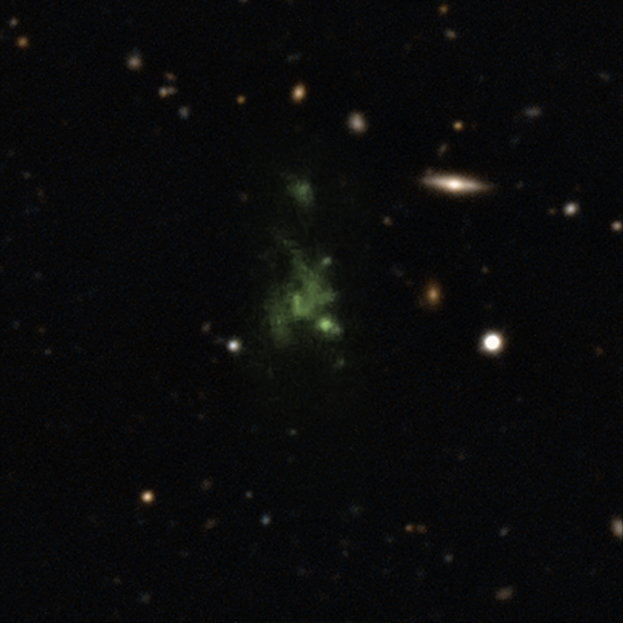
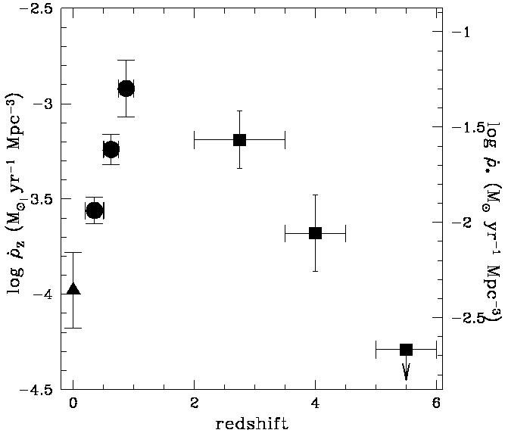
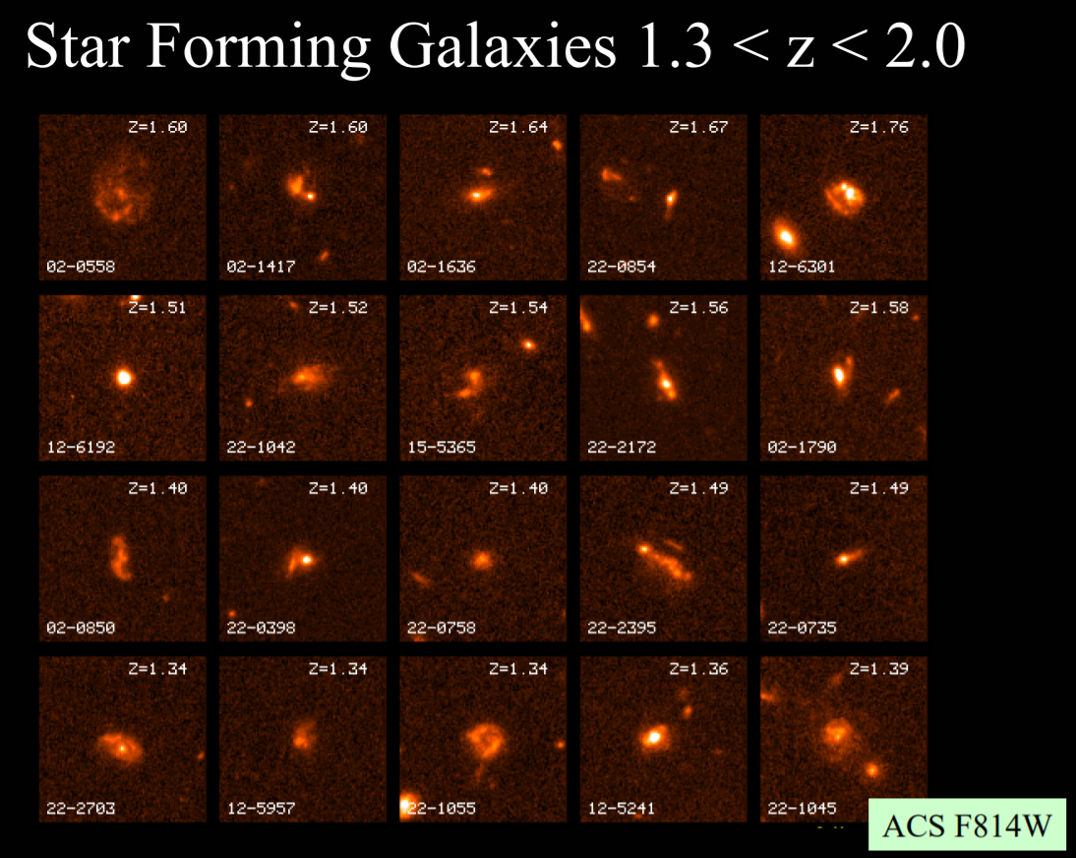
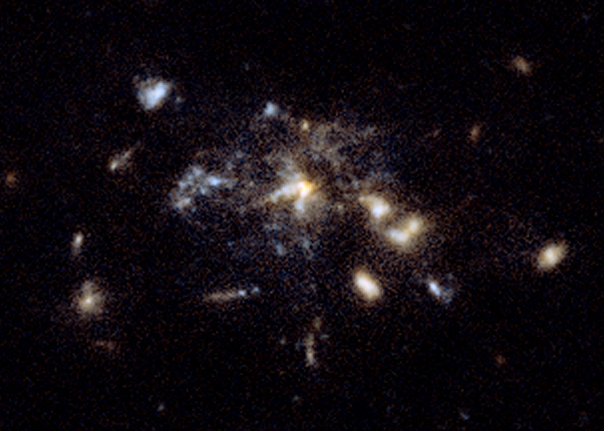
The past is a foreign country
Environmental effects may be time dependent ! (again, see Dressler 2004)
In early Universe, no clusters – ram-pressure effects would have been very different
Population III stars and reionisation
THE BLOB
2 Gyr after Big Bang
Contains three sub-mm galaxies with s.f.r. ~100 M⊙..yr⁻¹
Even brighter sub-mm sources may have s.f.r. ~6,000 M⊙ yr⁻¹ at 1.5 < z < 6
How rapidly did most discs assemble ?
Problems of very old elliptical galaxies
The BLOB
Notes:
Madau plot
https://ned.ipac.caltech.edu/level5/Illingworth/Ill5.html
Star formation rates in sub-mm galaxies :
http://adsabs.harvard.edu/abs/2014ApJ...784....9B
ALMA uncovers secrets of giant space blob :
http://www.eso.org/public/news/eso1632/

Slide 17
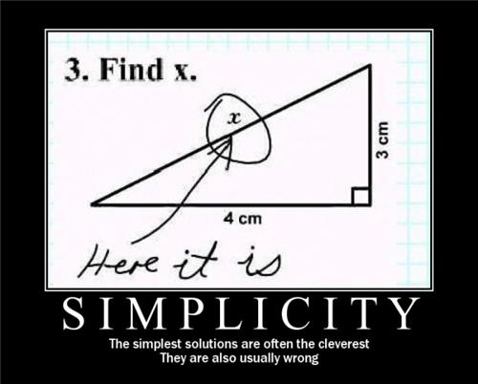
So maybe it was too simple, after all ?
Maybe there are some entities that need multiplying !
Galaxies are distributed along filaments. How significant is that in their evolution ?
Our understanding of the UDGs is still woefully incomplete :
Where are they ?
How many are there ?
What is their stellar mass and how do they affect the luminosity function ?
How many have gas ?
What is their total mass ?
Many known unknowns ! Expect rapid developments and discarded models

Slide 18
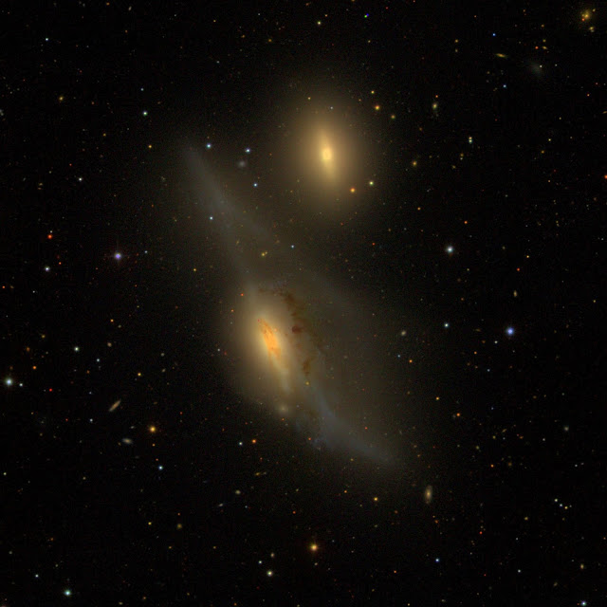
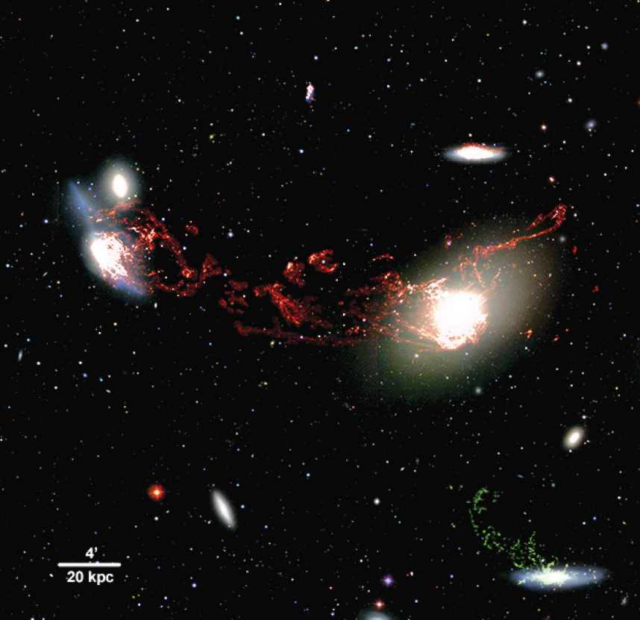
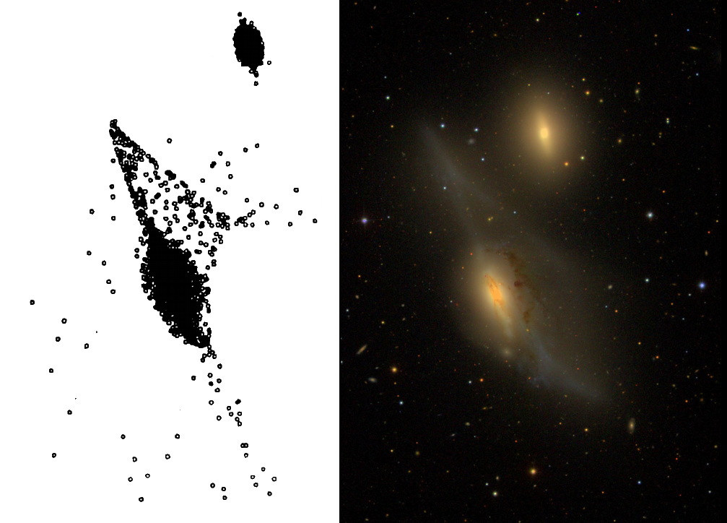
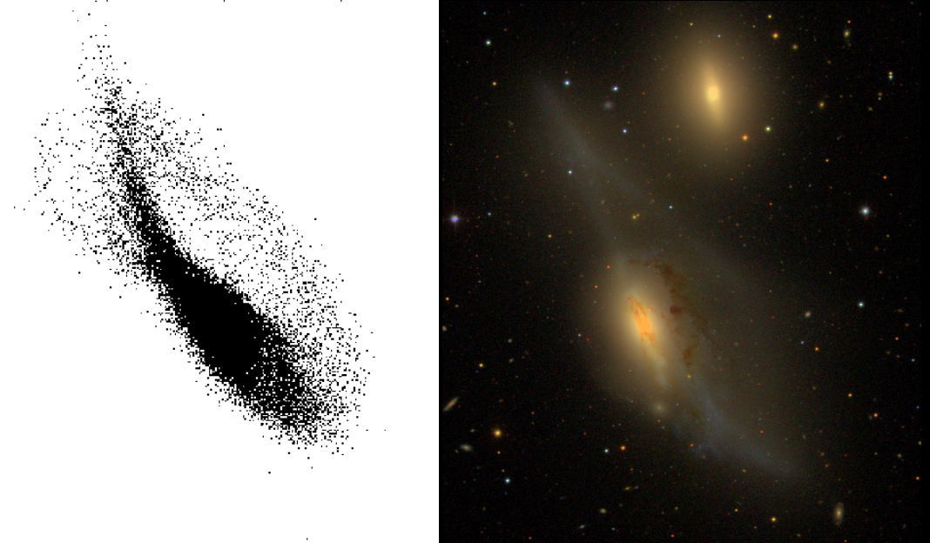
If it agrees with experiment…
But… getting the right answer is a necessary but not sufficient condition
Because of the complexities, it’s possible to get the right answer by completely the wrong method
This can manifest itself even at the level of very precise details !
Always consider multiple possibilities
Must be done with sincerity, don’t construct straw men because they can’t fight back
Only in extreme cases can you ever prove a theory
The Universe is under no obligation to make sense
Follow the data wherever it leads, but don’t marry it
Notes:
Makarian’s Eyes first simulation :
http://adsabs.harvard.edu/cgi-bin/bib_query?1988A%26A...203L...9C
Second simulation :
http://adsabs.harvard.edu/cgi-bin/bib_query?2005A%26A...441..473V
Halpha tail :
http://adsabs.harvard.edu/cgi-bin/bib_query?2008ApJ...687L..69K

Slide 19
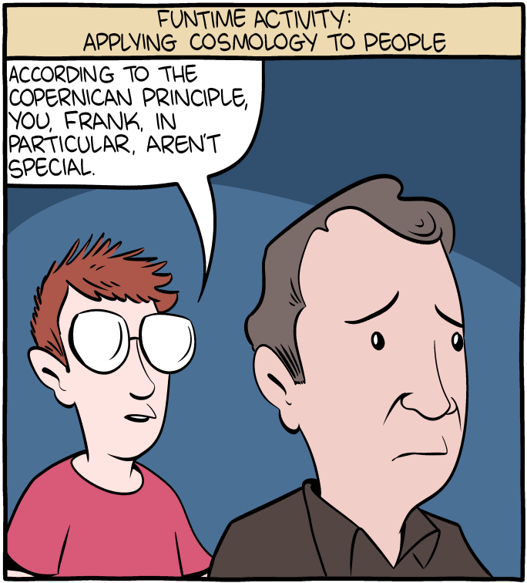
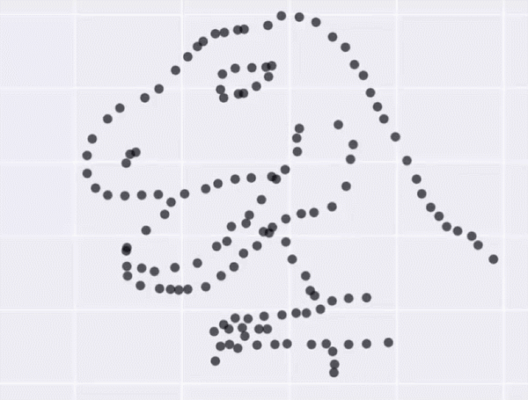
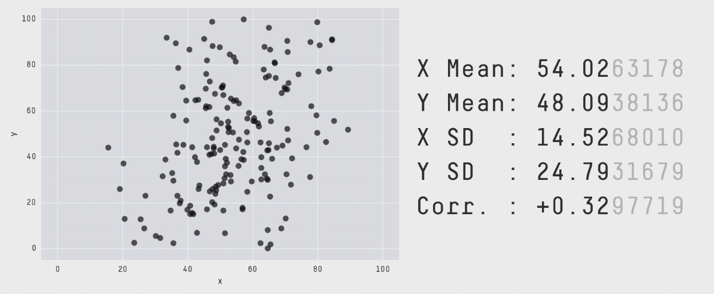
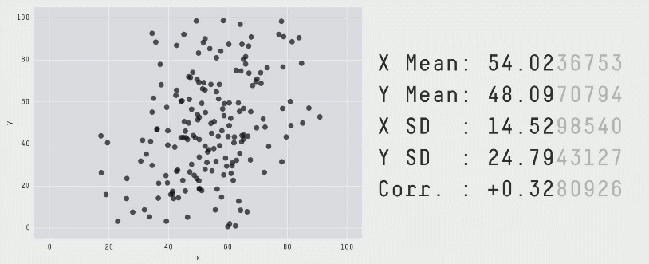
Not even wrong ?
Quantification of limited use : sometimes subjectivity is better ! Not everything can be measured
Limitations of statistics
Merely knowing the values doesn’t tell you very much
Understanding the meaning of a correlation depends on you, not the data
“Flaw of averages” has literally saved lives..!
There’s no such thing as an ordinary galaxy : have to disentangle complex effects working simultaneously
Process inevitably involves many mistakes
Notes:
Credit to SMBC for insulting people with the Copernican principle :
https://www.smbc-comics.com/comic/cosmology
The “flaw of averages” :
https://www.thestar.com/news/insight/2016/01/16/when-us-air-force-discovered-the-flaw-of-averages.html
Datasaurus :
https://www.autodeskresearch.com/publications/samestats

Slide 20
Example : quantifying sensitivity
$$M_{HI}=2.36×{10}^{5}×d^{2}×S/N×σ_{rms}×W$$
This means that as W↑, S/N↓ at constant M !
So defining a mass sensitivity (for objects you’ll actually detect) is, strictly speaking, impossible.
Furthermore, in reality W and S/N are correlated because of inclination => complex selection effects
We need a survey to be as sensitive as possible
Resulting catalogues must be complete and reliable
Raw sensitivity can be calculated, but this doesn’t mean this is what you’ll actually detect
A sensitivity limit is not the same as a completeness limit !
Can estimate reliability and completeness using artificial sources, but can never be certain of what’s really in the data
Can give a hard mass sensitivity limit, but not an exact completeness limit

Slide 21
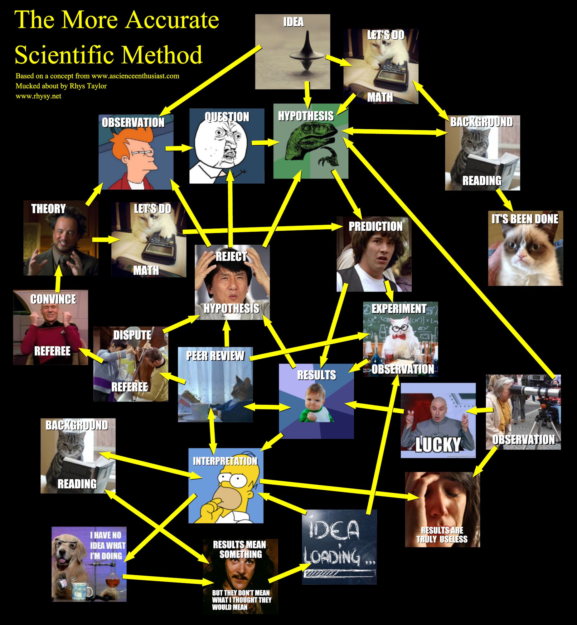
Summary : Science Is Hard
REMEMBER THE ELEPHANT !
Start simple. Add complexity as needed. But if a simpler alternative comes along, prefer that one if it works.
Handle Razors with care
Selection effects can create trends where none really exist, or exaggerate ones which do
A model which agrees with observations doesn’t preclude there being other models which also agree or do even better
Statistical measures are not always trustworthy !

